Slide 1


Blended Learning – F2F SESSION
TITLE: EXISTING & EMERGING TECHNOLOGIES
FACILITATOR: COLM DUNPHY
DATE/TIME: FRIDAY 12 FEB 2016, 9.30 – 13.15 GMT
#WITBLEET

Slide 2
RECAP
SESSIONS
Existing & Emerging Technologies
Blended Learning Intro
Learning Theories – Catherine
Models (Design) – Dominic
Technology (Implementation) – Colm
Other Considerations - Áine & Fionnuala)
Culture
Language
Learning Spaces
PD Week Sessions
Assignment Workshop
DEMO DAY
Introduction
Before Class (TODOS)
Optional Video Session (Adobe Connect)
F2F
Moodle Activities
Notes:
Catherine’s session is being inserted next . All others pushed out.

Slide 3
CLASS – PLAN
09.30 Welcome (10 mins)
Outline of the morning
09.40 Review of “Before Class”(40 mins)
TedEd Activity
Surprise 1
10.20 Moodle Activities (10 mins)
Quick Scan in student mode Choice, Feedback
10.30 Peer Review (20 mins)
10.50 Doodle / Wordle (10 mins)
11.00 Adobe Connect (15 mins)
Surprise 2
11.15 COFFEE/TEA BREAK ( 20 mins)
11.35 Collaboration – Blended Learning Toolkit (50 mins)
You populate with your research (35)
Suggested Examples (5)
My Choices (10)
12.25 Learning Analytics(5 mins)
12.30 BL At Wit Discussion (10 mins)
Digital Champion
12.40 BLEET Examples (15 mins)
12.50 Assignment Discussion (5 mins)
12.55 WRAP UP / LO / Qs (5 mins)
13.00 MISC / OVERRUN!
13.15 LUNCH

Slide 4
“Before Class” - REVIEW
Mixture of LMS(MOODLE) & WEB 2.0

Slide 5
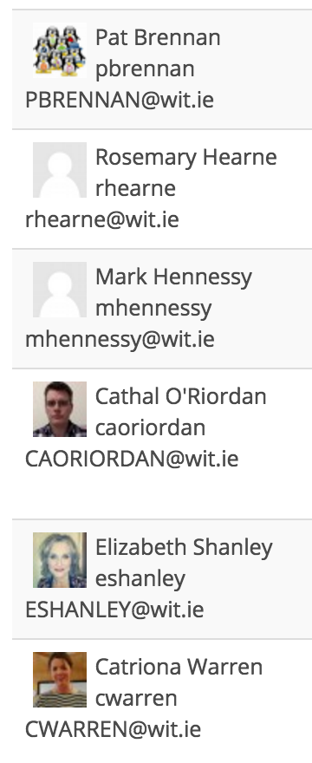
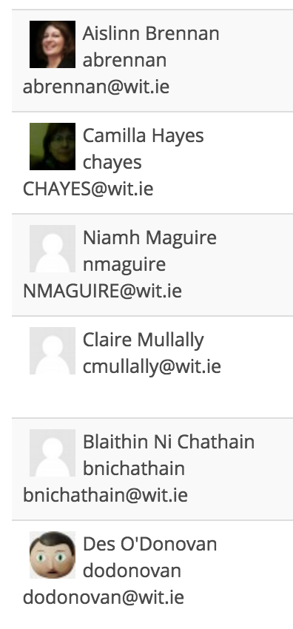
GROUP X
GROUP Y
Notes:
Photos of yourself please – For recognition / empathy

Slide 6
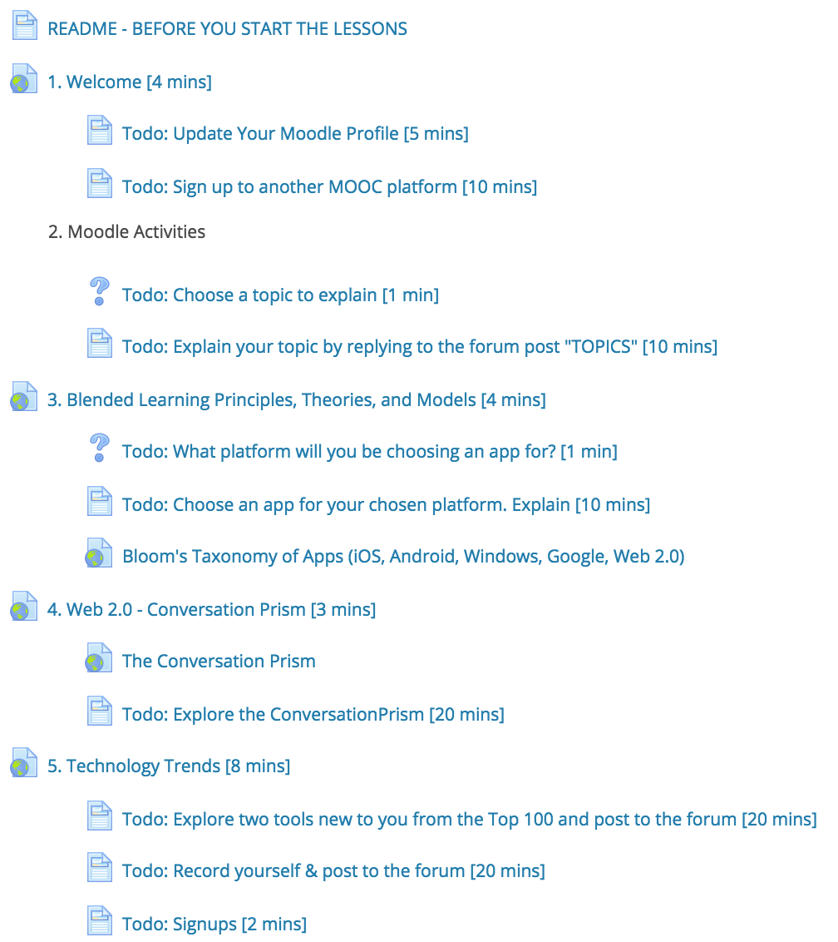
TODOs BEFORE CLASS
Lets run some
POLLs:
Moodle Feedback
Google Forms
1
2
3
4
5
6
7
8

Slide 7
The Look
Substance is more important than style, But Style is very important.

Slide 8
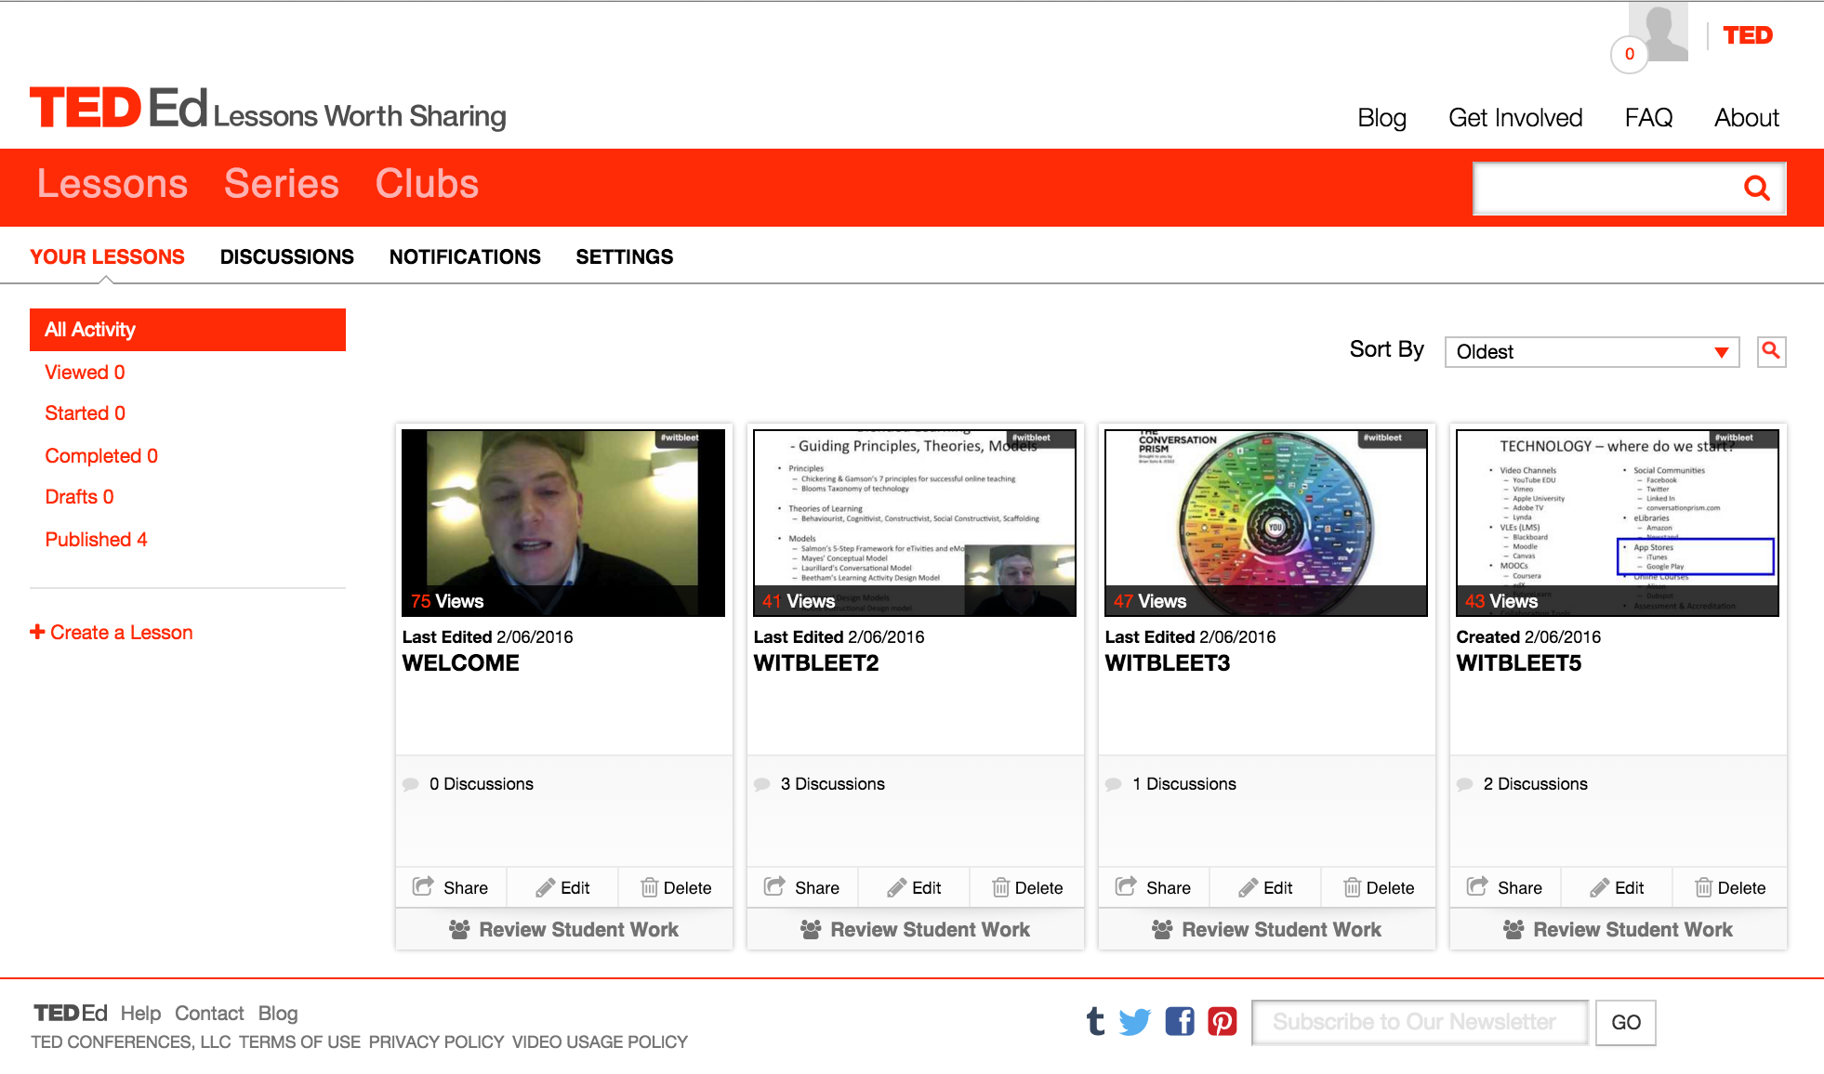
An Alternative to last week’s Moodle experience

Slide 9
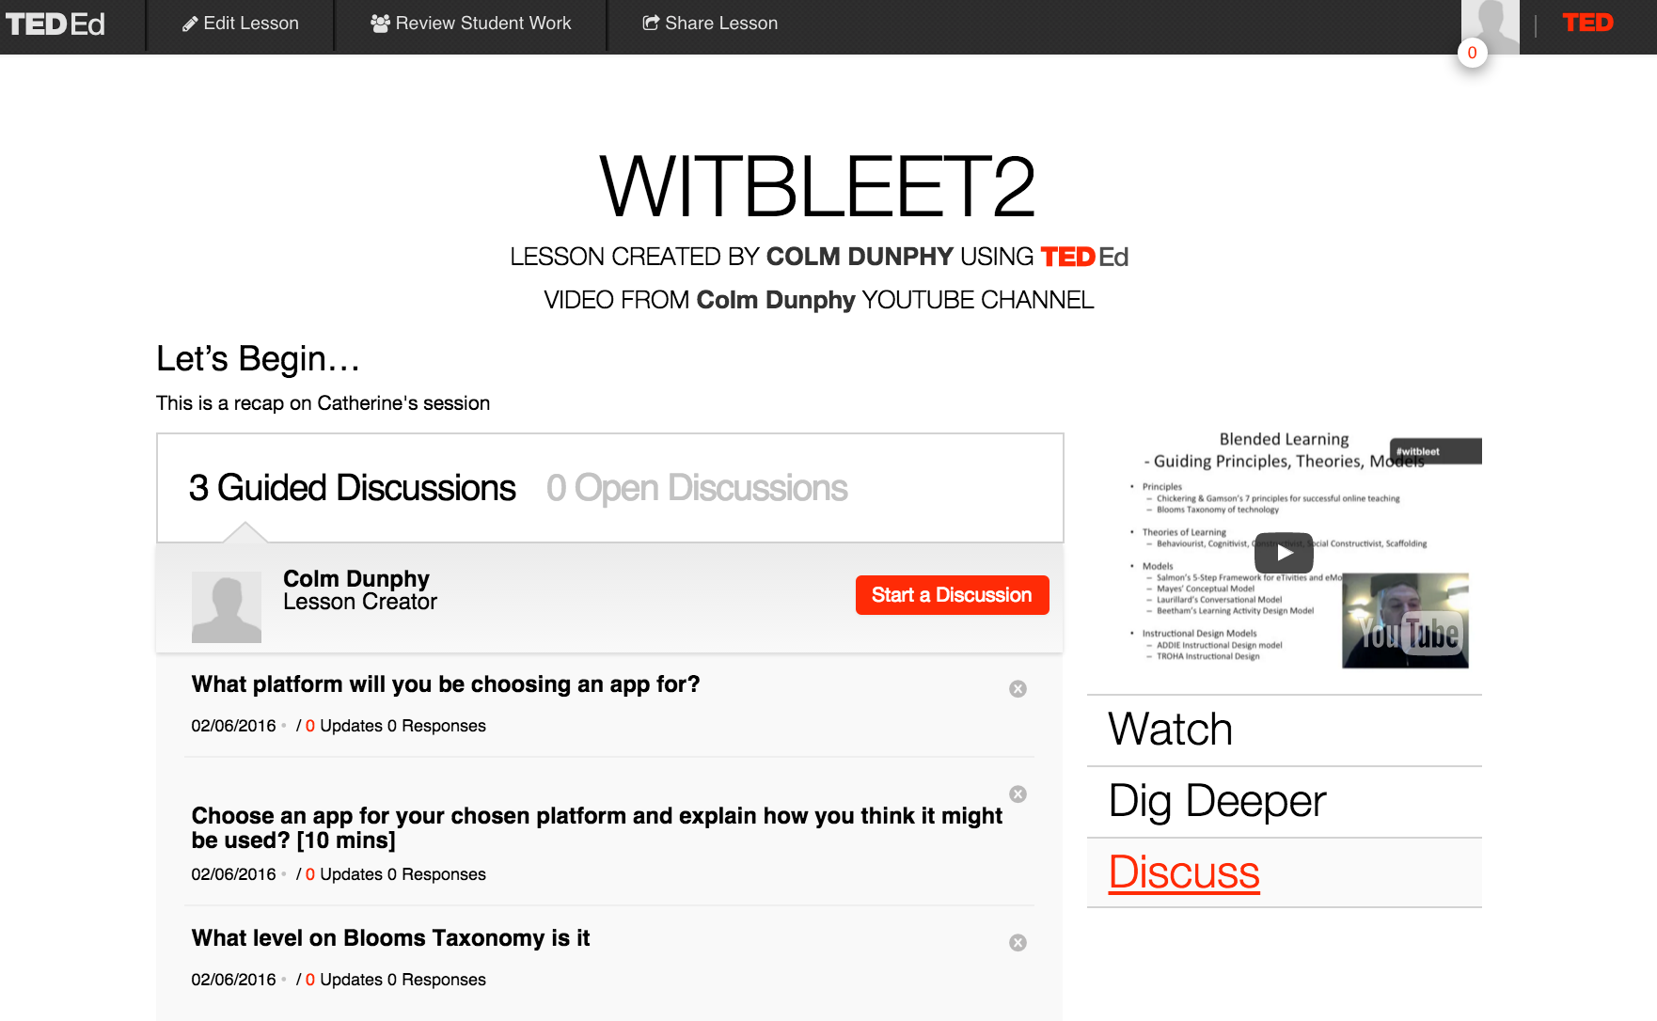

Slide 10
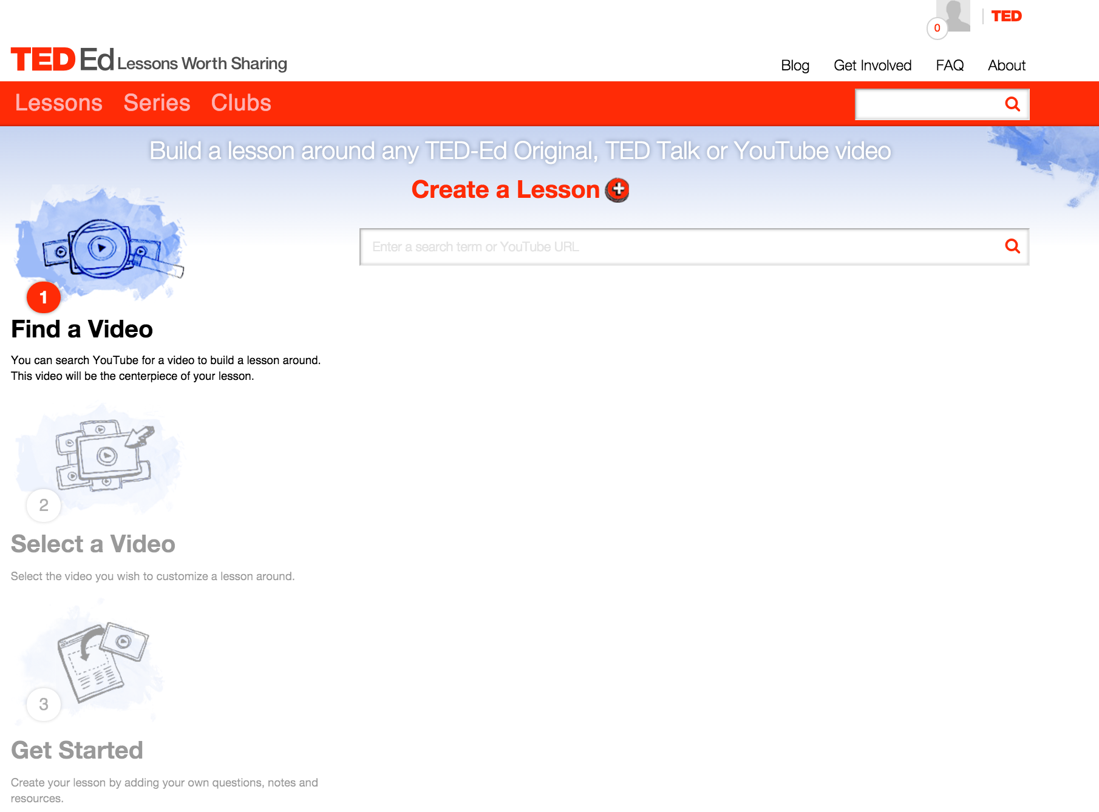
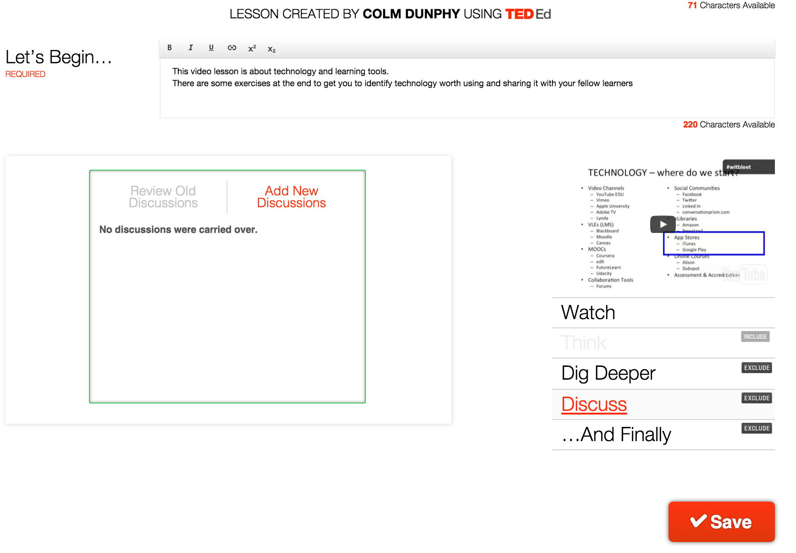
Activity
You signed up to TedEd before class (ed.ted.com)
Now create a short lesson for your own video, or for a video you use in class

Slide 11
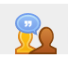
PEER REVIEW

Slide 12
Peer Review (Moodle Workshop) - 1
Agreed published marking scheme (rubric)
Clear for the student
More involvement by student (and the lecturer in setting it up)
Encourages reflection
Feedback
Graded by peers > work harder
Only way to work with massive classes (e.g. 50,000 students)

Slide 13
Peer Review (Moodle Workshop) - 2
Takes time to learn, to setup, and adminsiter
5 Stage Activity, you should enable each stage manually usually
Teacher Setup
Describe the assessment
Explain how to submit
Create the marking scheme / rubric
Provide an example
Submission
Explain how to submit
Students submit their work
Allocated to peers (use ODD number)
Assessment
Self
Peers (ODD number)
Teacher
Grading
Invisible to students
Grade for submission (e.g. 80%)
Grade for how the student assesses (e.g. 20%)
Based on std deviation from the star assessment
Combined to give OVERALL Grade
Closed
Grades and comments are now available to students
Notes:
Manually because students miss the deadline. MOOCs don’t care

Slide 14
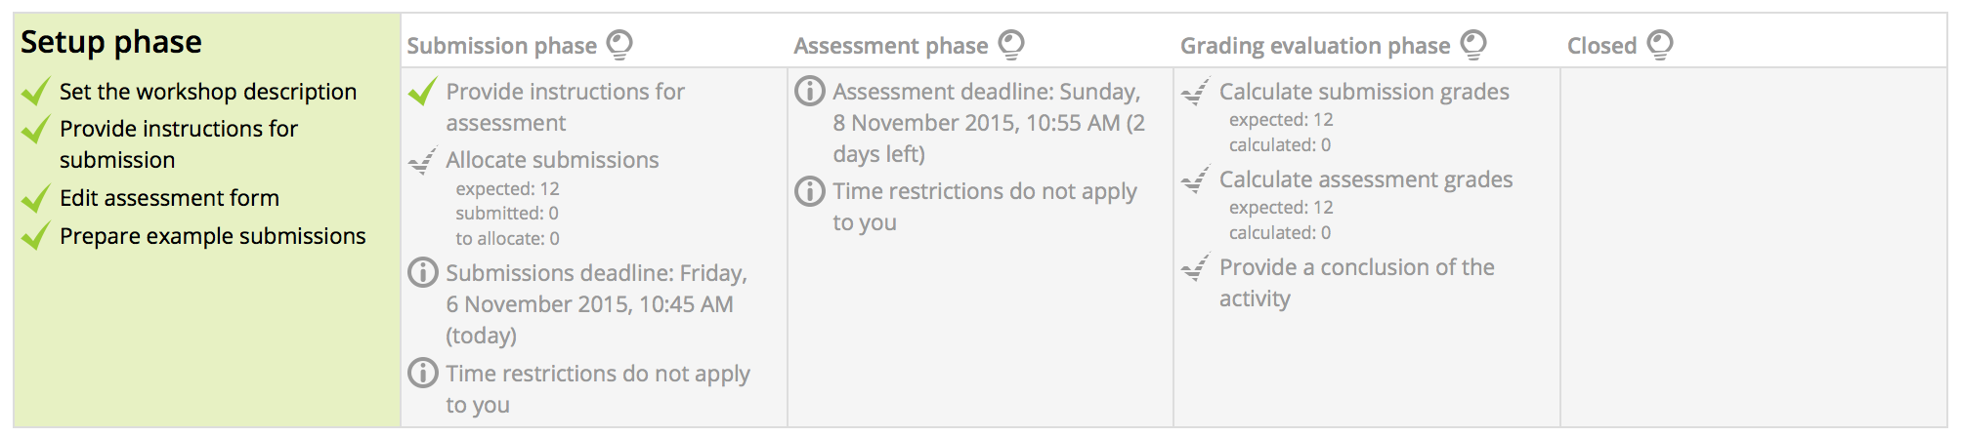
Peer Review (Moodle Workshop) - 3

Slide 15
CASE STUDY: Music Keyboard Skills Video Test
You really need to study the different phases and the requirements for each
You need to be very clear about the assessment and the marking scheme / rubric before you start
You need an example answer(s), and then you need to assess it
Deadlines are really important for each stage.
When students submit you need to allocate
Then switch to assessment stage which also has a deadline
The stages can be switched automatically but it’s ruthless!
Results are surprisingly consistent.
Apply the consistency to the right final grade is what I need to work on
Just like you first written exam, it takes time to find the right balance of easy / hard

Slide 16
DOODLE

Slide 17
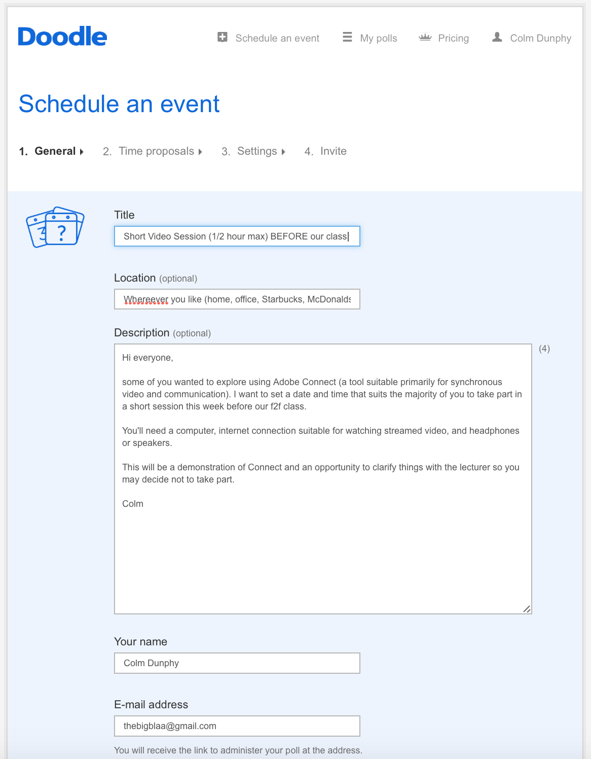
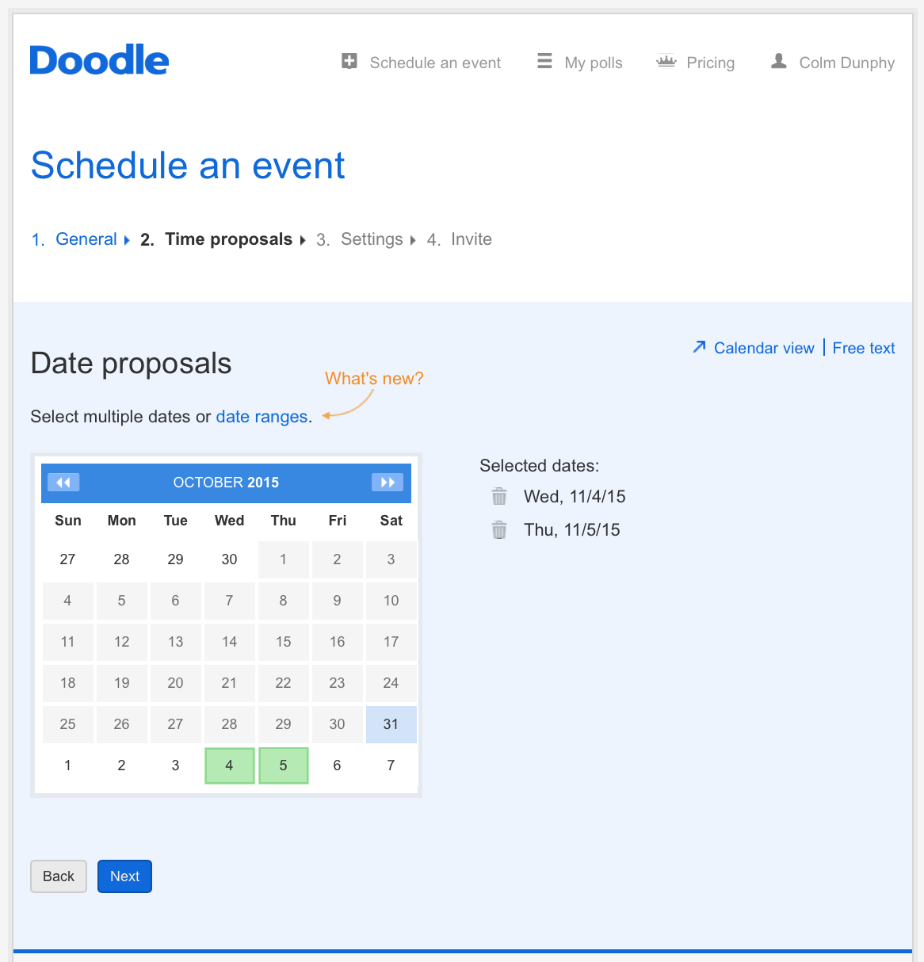
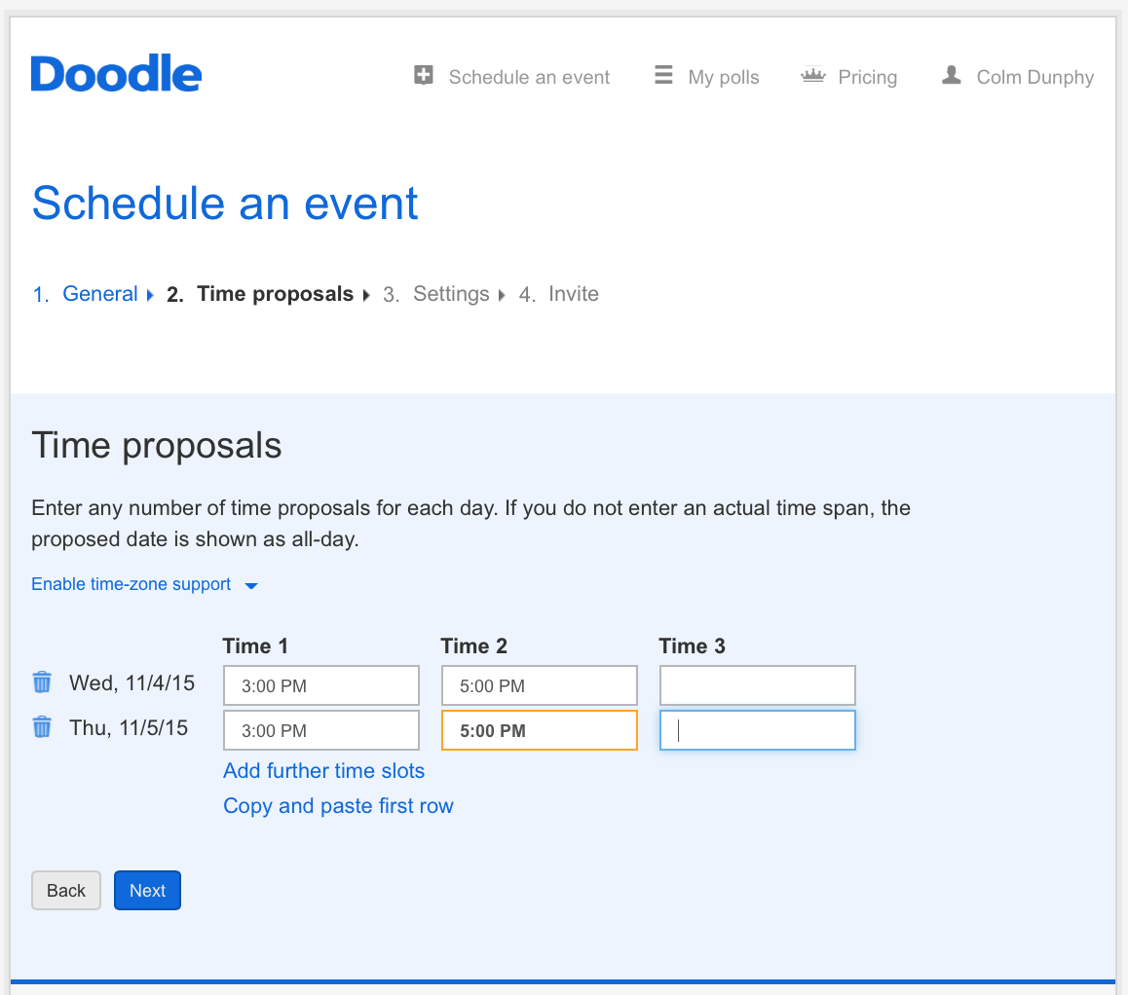

Slide 18
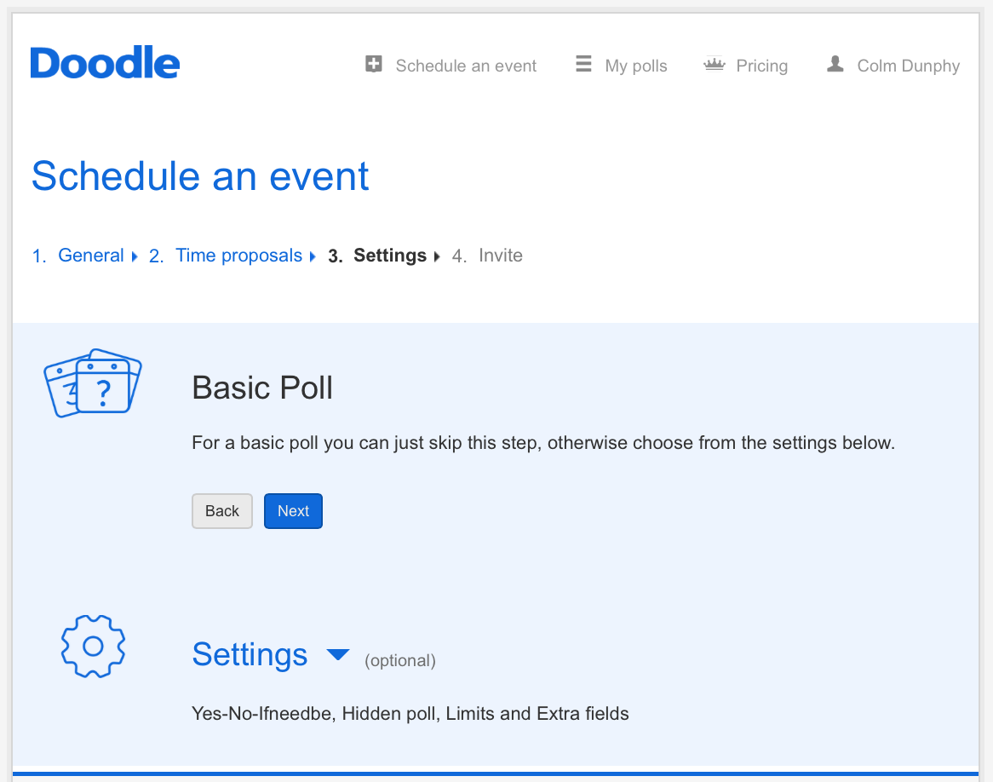
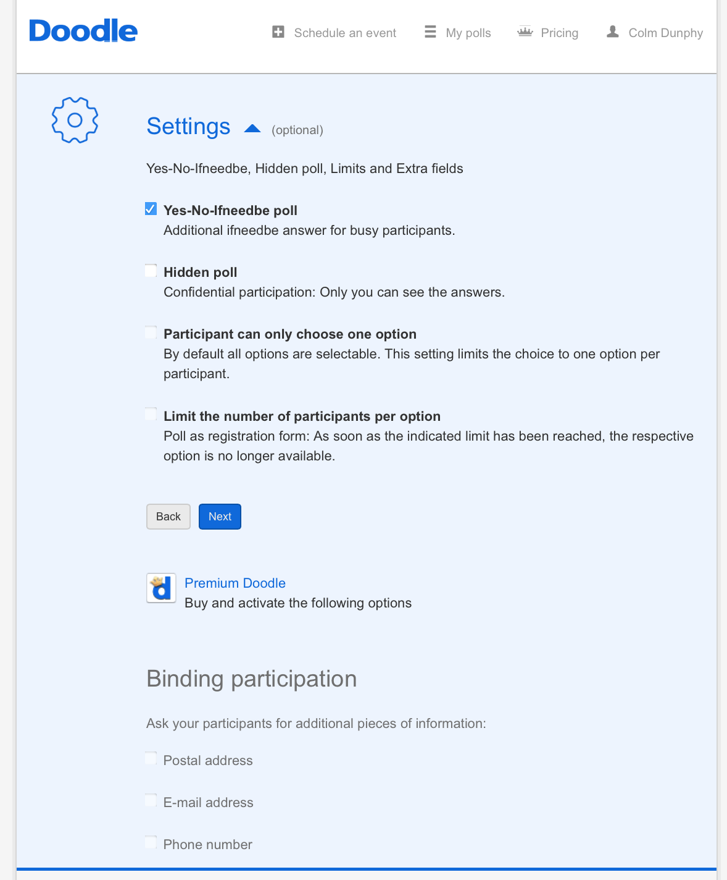
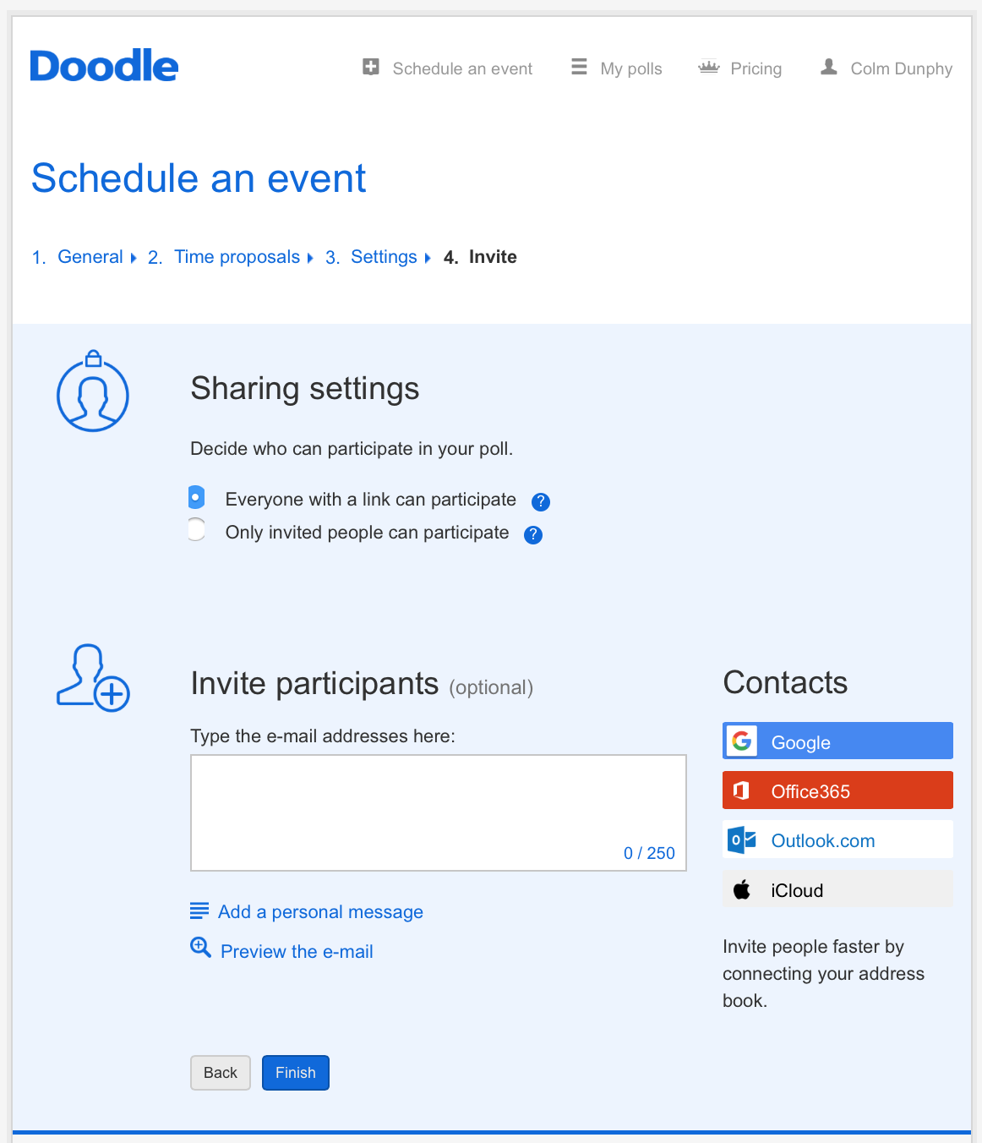

Slide 19
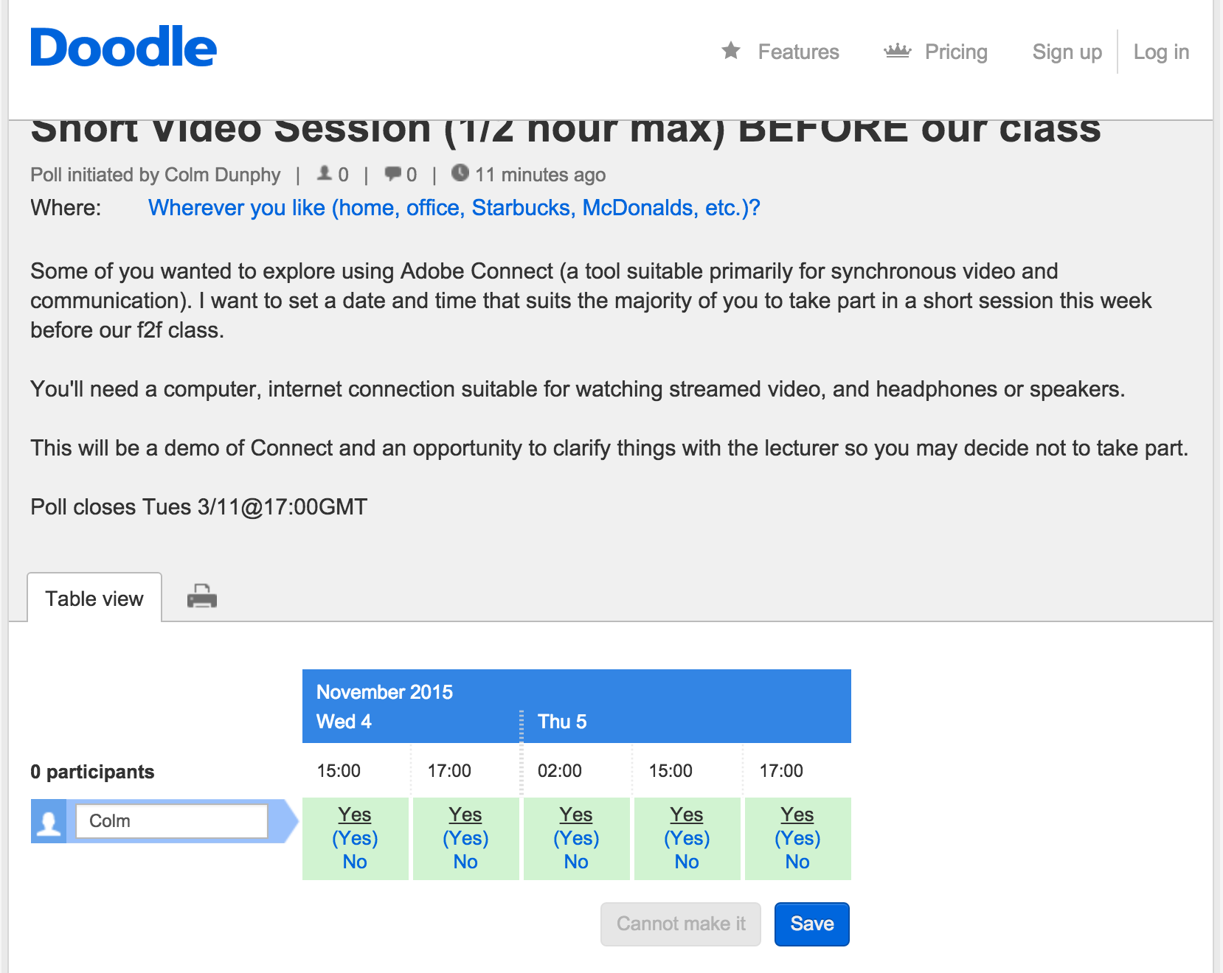
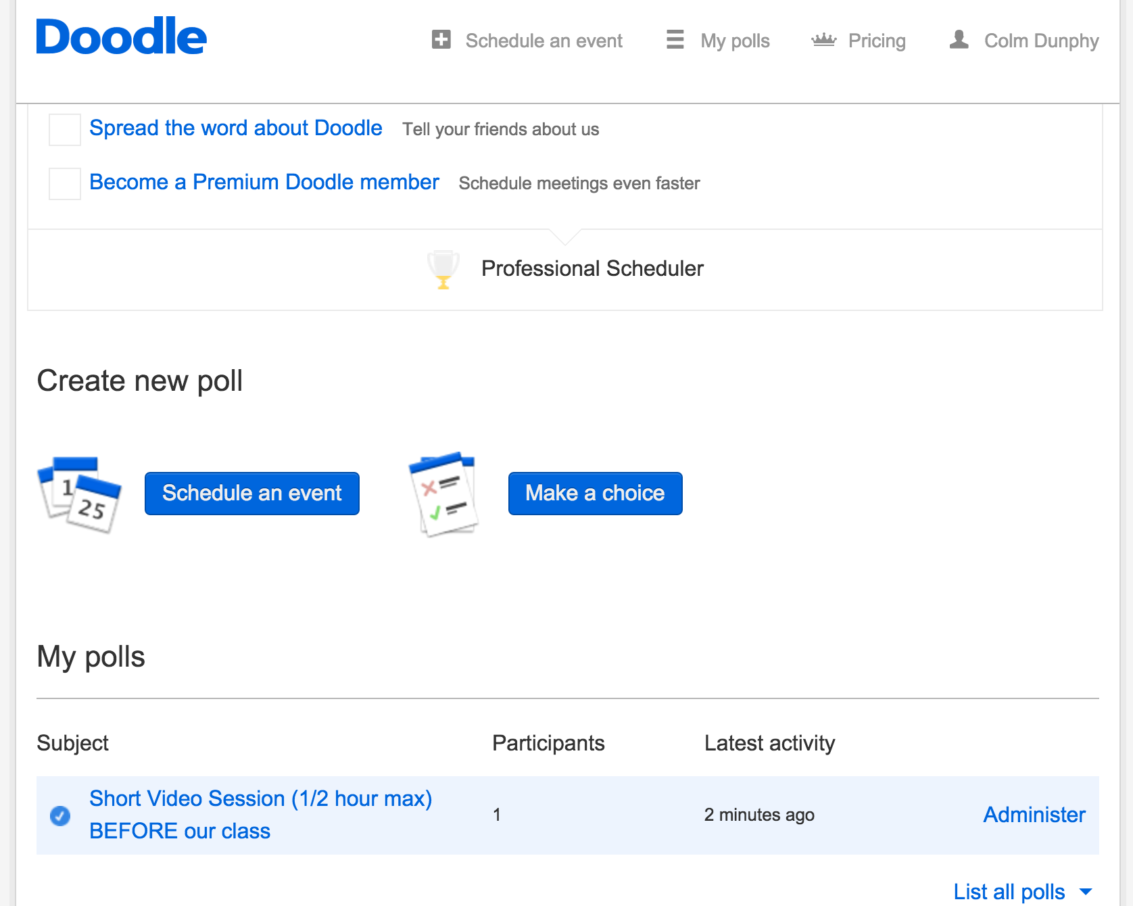

Slide 20
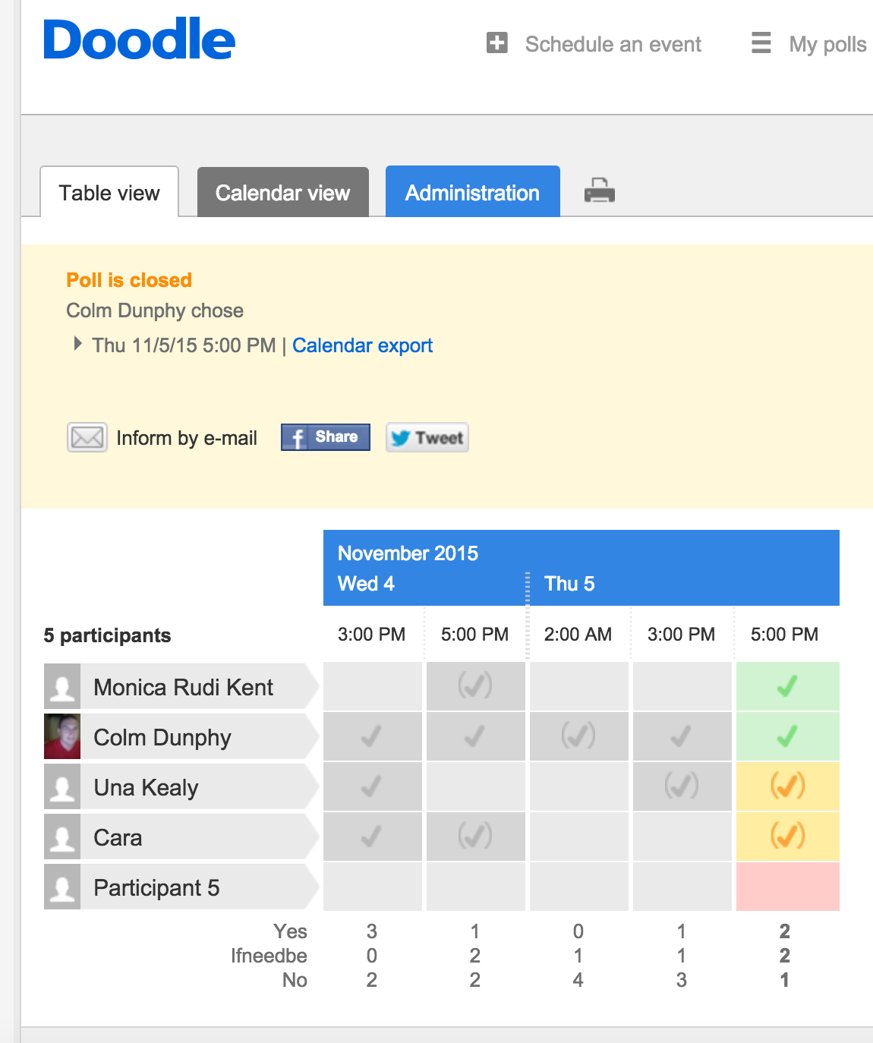

Slide 21
ADOBE CONNECT
REVIEW SESSION

Slide 22
Video is available in Moodle
Slides are available in Moodle
Discuss…

Slide 23
TEA BREAK
RESUME AT 11.35

Slide 24

BLENDED LEARNING TOOLKIT
USING GOOGLE DOCS

Slide 25
Our Blended Learning Toolkit
Collaborate and make it!
https://docs.google.com/document/d/1-GfUOeNFh0Px8b9dxPcE6NnrRiEyLxAEKDiQh8fyv28/edit?usp=sharing

Slide 26
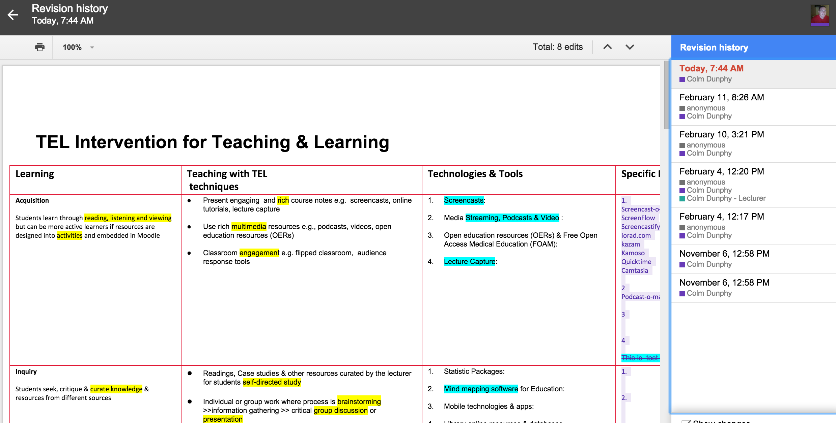

Slide 27
LEARNING ANALYTICS

Slide 28
Learning Analytics
Who engages?
When?
Week 6/7 dropout
Moocs
Engagement?
Disengagement?
Why?
Lecturer
Strategic Management
Measuring Modules
Analyse
Clasify
DCU “PredictEd” project
Student background
Results
Year 1 grades
Secondary School
What can we do to bolster support for students
Retention – is now the main issue for retaining funding

Slide 29
BL @ WIT

Slide 30
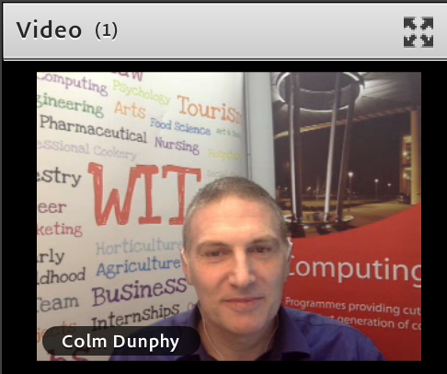
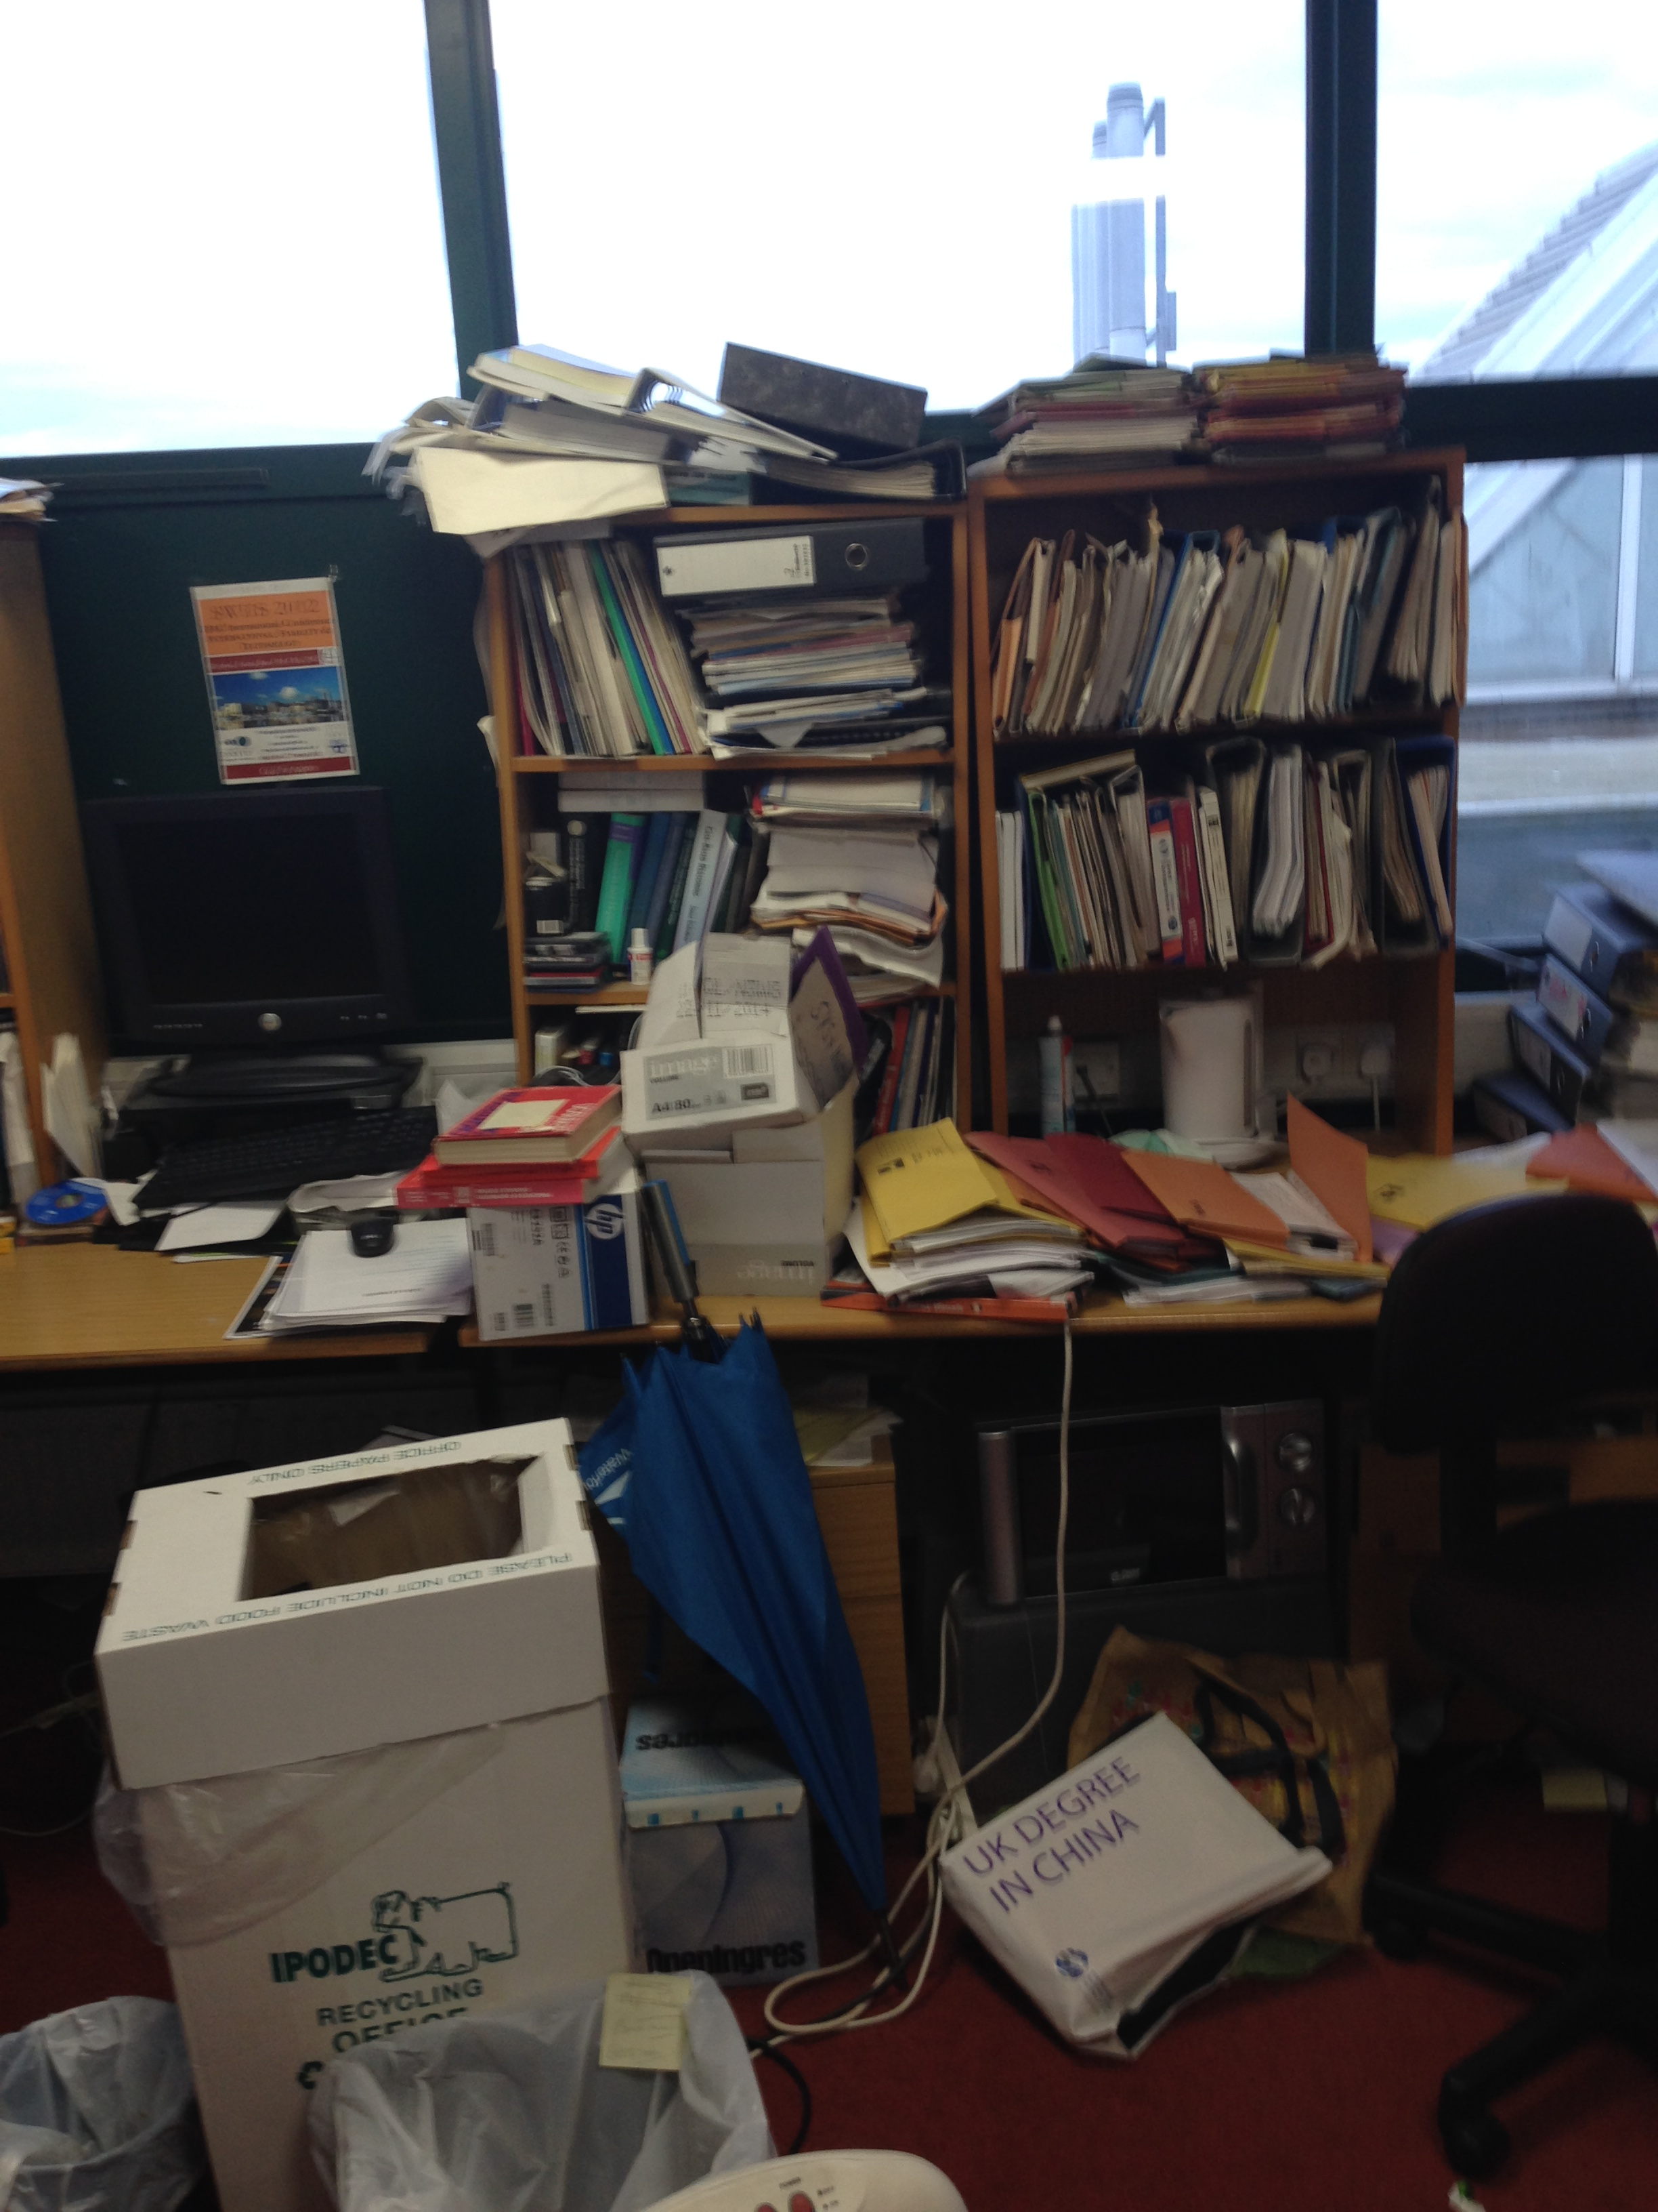

Slide 31
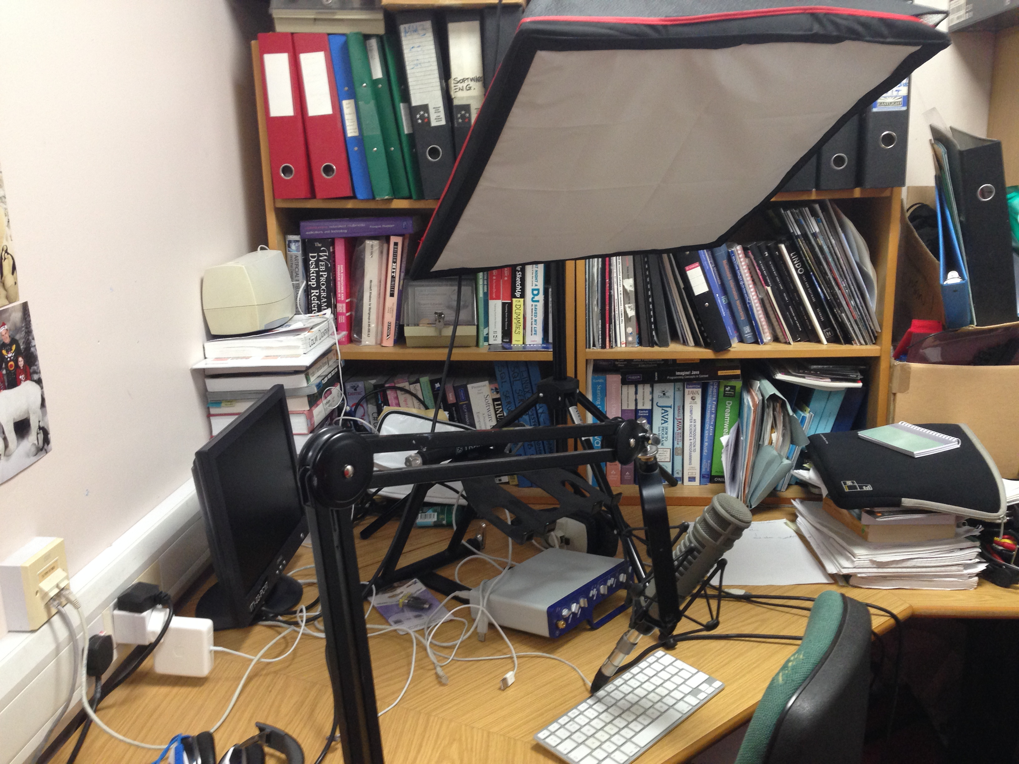


Slide 32
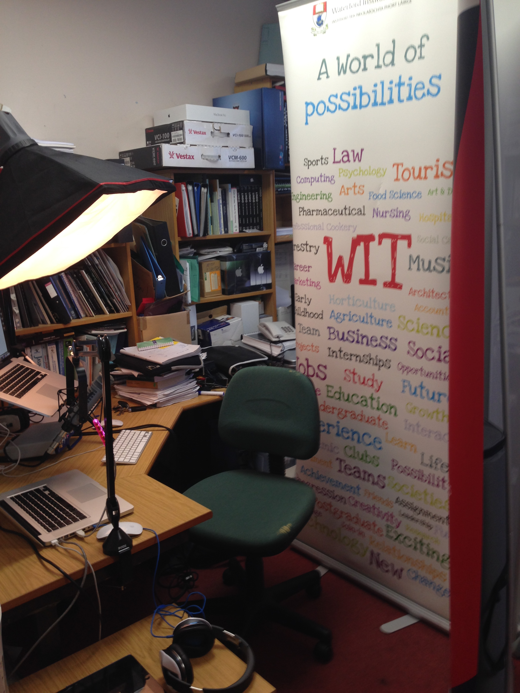


Slide 33
MISC
Bit.ly
Dropbox
Google Docs
SaveFrom.net
Keepvid.com
Movie Maker
Adobe Acrobat Reader

Slide 34
EXAMPLES ASSIGNMENT DISCUSSION FINISH

Slide 35
FINAL WORDS
Far too much to know it all
Improve what you have by adding activities and adding content to suit a different learner type
Evaluate & Improve your blended module with each delivery iteration
Respect copyright but don’t be a slave to it
Cost / Benefit / Time
I bet you’re already delivering in a web enhanced mode, maybe even blended mode.
Hopefully you’re better equipped to improve it now
(digital media, peer review, discussion, collaboration )
Thanks

